Slide 1
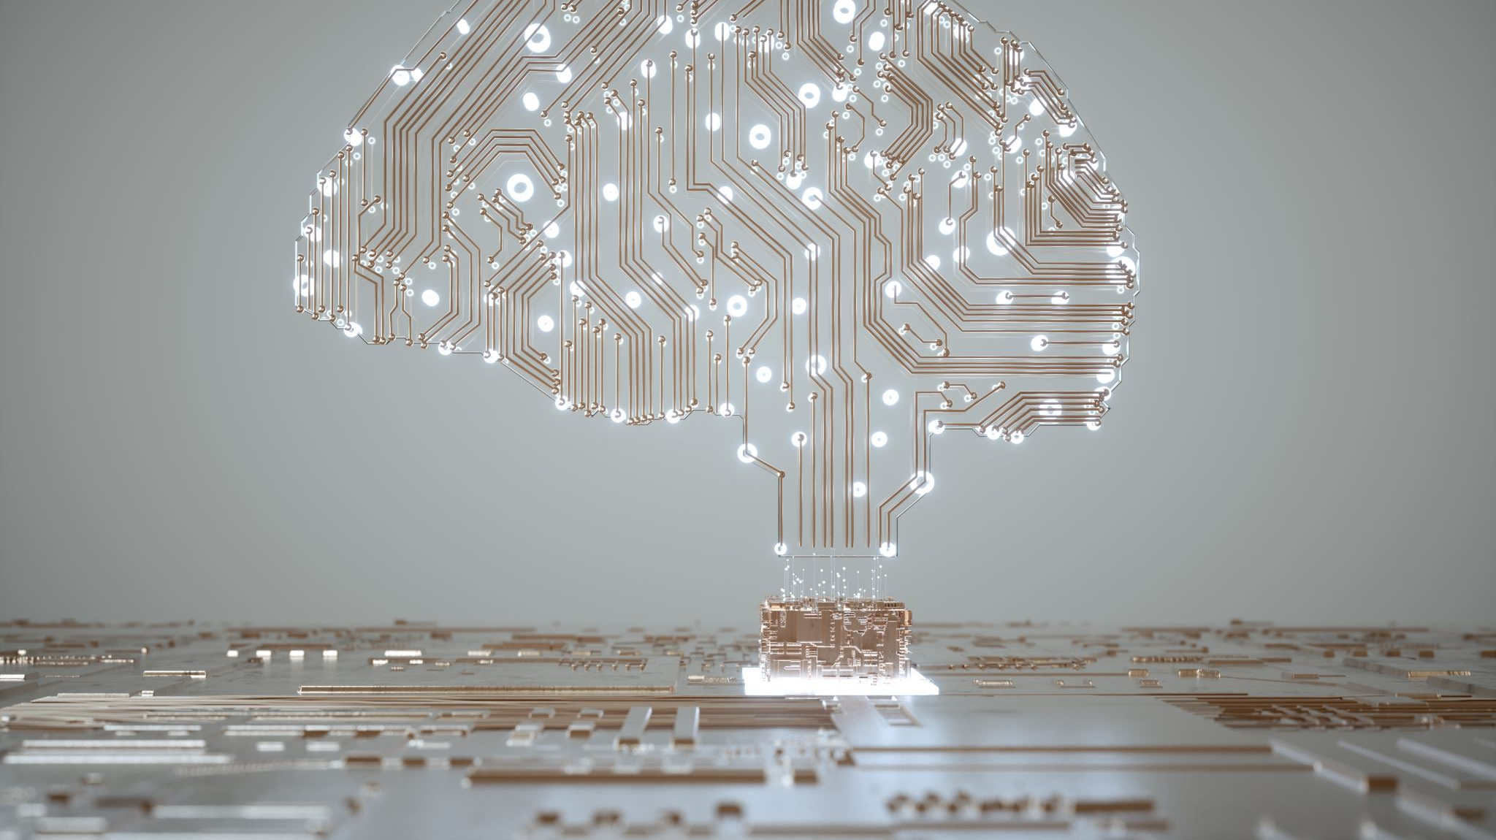
Ethical considerations for the use of brain computer interfaces for cognitive enhancement
Samuel Oriola Undergraduate Researcher

Slide 2
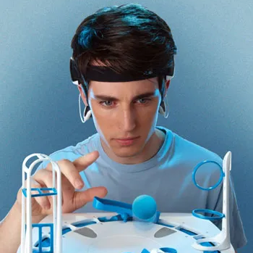
What is A Brain Computer Interface (BCI)?
A Brain Computer Interface is a system that allows communication between the brain and external device to interact with the environment. EX Brain signals to control a limb, EEG, and Mindflex
BCI (or at least the research) has been around since the 1970’s with Jacques Vidal coning the term “brain-computer” with his paper in 1973

Slide 3

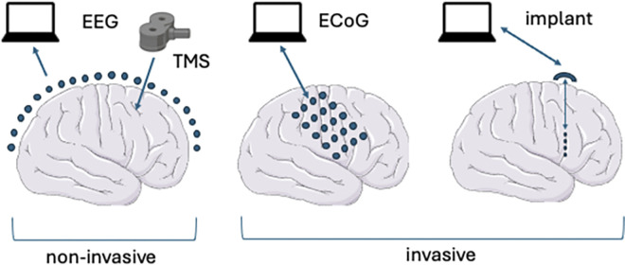
BCI - Invasive vs Non-invasive
Noninvasive BCIs record from outside the skull.
Invasive BCI record from underneath the skull, and electrodes implanted inside the brain.
Noninvasive BCIs are easier to deploy, but will generally lack the precision of invasive BCIs and will also generally lack the ability to stimulate brain activity
“Inside out” vs “Outside in”
This paper focuses on invasive BCIs (or the more fun one)
EX. Electroencephalograph (EEG) vs Electrocorticography (ECoG)

Slide 4
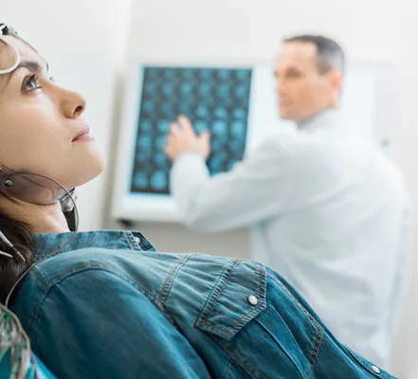
BCI for Clinical vs Cognitive Advancement
BCI for Clinical Advancement is more common with GOOD and PRODUCTIVE outcomes, such as but not limited to
Early uses helped decode movement and speech commands from paralyzed patients
Ameliorate symptoms of Parkinson’s disease
Control epilepsy
Relieve severe depression
In development restoring vision in blind people
Treating chronic pain
Bypassing damaged parts of the spinal cord

Slide 5

BCI for Clinical vs Cognitive Advancement
BCI for Cognitive Advancement is more known in capitalism and Star Wars
Neuralink’s mission statement is to “restore autonomy to those with unmet medical needs today, and to unlock human potential tomorrow.”
eBCI- BCI used for enhancement rather than substituting a need
This paper focuses on eBCI (or the more concerning one)

Slide 6

Current limitations of BCIs
(Constraints can be divided into two (overlapping) categories: engineering [limits of nodes] and scientific[what does the brain even do].)
These constraints can be mitigated, but they exist
Such as using precise BCI to stimulate and record neural populations
Using machine learning algorithms for classification and prediction (if you a metric ton of it)

Slide 7

eBCI Potential
Think of all the cool things we could do!
We could modulate mood, enhance memory, limit language barriers, change our capacity for knowledge, and change the “bit-rate” of human cognition
But think WIDER
We could improve reaction time, sensory sensitivity, control robotic limbs, perceive new things (like sonar or different colors), and TRANSCEND COMMUNICATION.

Slide 8

eBCI Potential
THINK of SOCIETY
If EVERYONE improved their cognitive skills, we could research, synthesize, and discover faster. Which would improve areas like climate change, disease, etc.
We could bridge connections across cultures and understand people on a deeper level

Slide 9

Key ethical questions surrounding invasive BCIs for cognitive enhancement
Okay so maybe some of the stuff mentioned is psychologically and philosophically implausible
Erosion of privacy
Inequality
Mental monoculture
Inauthenticity
Cheapened achievements
Loss of autonomy vs hyperagency

Slide 10
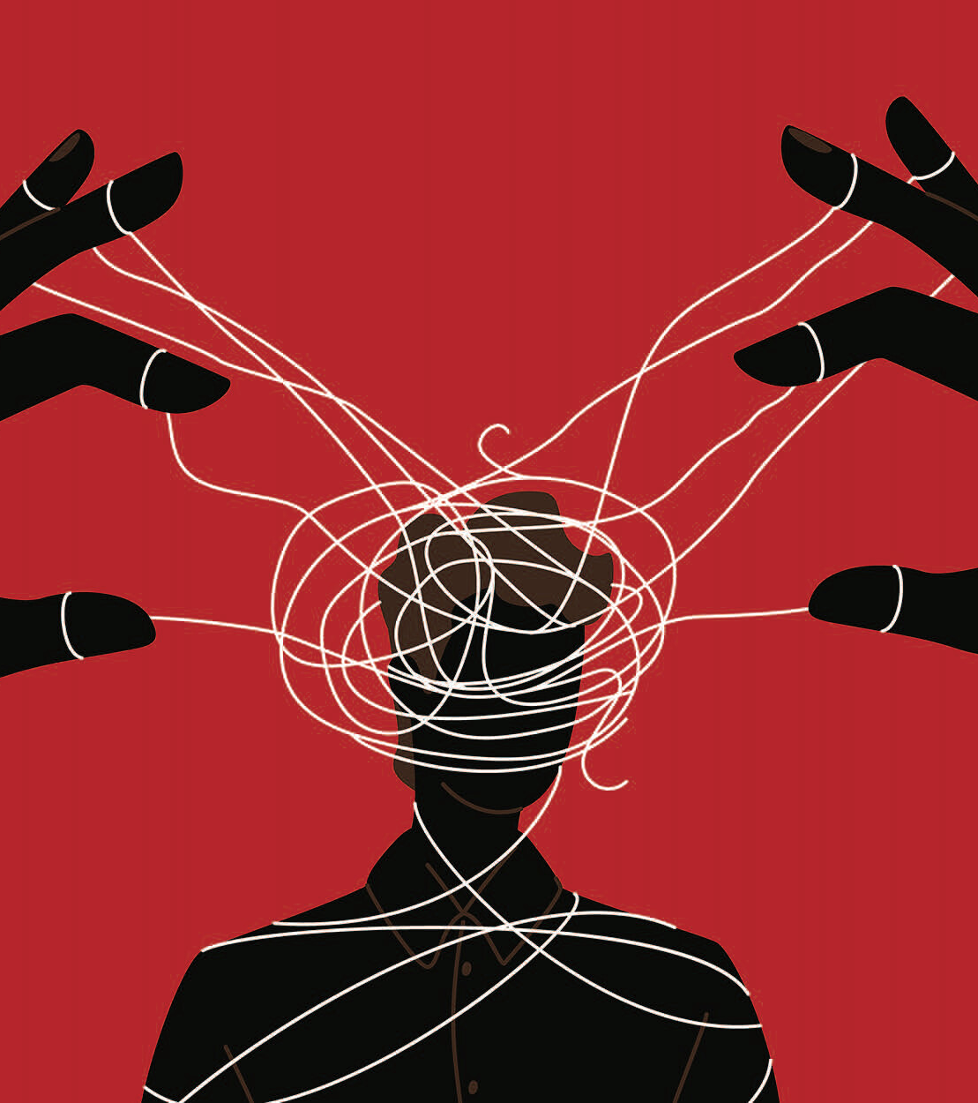
Erosion of privacy
To what extent does widespread use of eBCIs raise the risk of privacy erosion, such as thought violation or “brainjacking” where bad actors gain illicit access to neural data?
“Brain Jacking” - bad actors gain unauthorized access to what you are thinking
Current issue of LLM’s training on data they do not own
Social media devices/ AI Bots using your engagement for targeted ads and gaining trust

Slide 11
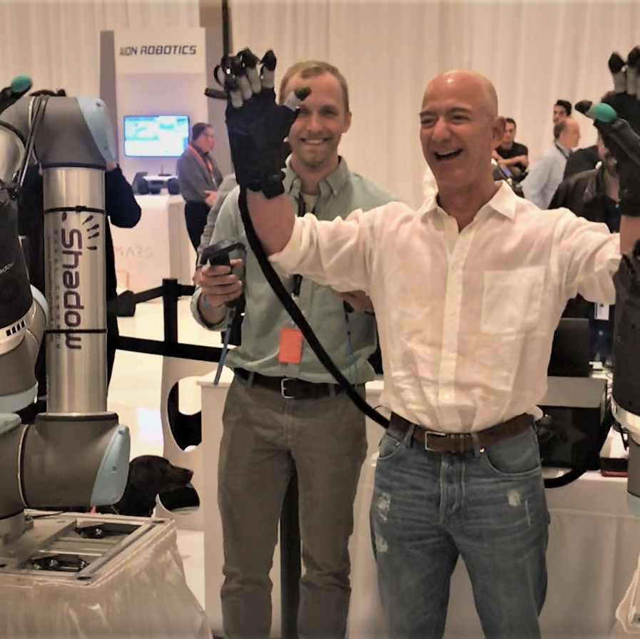
Inequality:
Could giving financially privileged individuals access to eBCIs further widen existing socioeconomic gaps by providing them an additional cognitive or intellectual advantage?
It (could) one day be more widely accessible. Ex Laptops

Slide 12
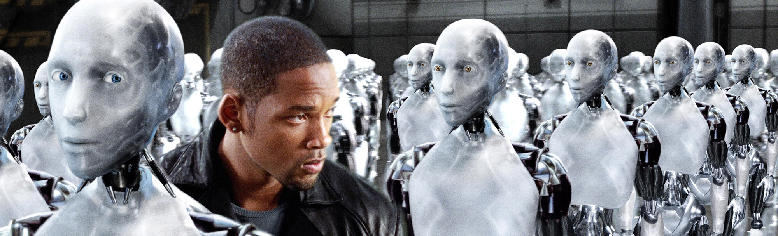
Mental monoculture:
Could the widespread use of eBCIs standardise cognitive processes, leading to diminished cognitive diversity and hindering innovation?
Cognitive diverse teams lead to better outcomes
Halting societal progression
EX. Assimilating Language

Slide 13
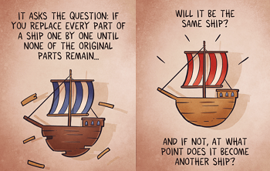
Inauthenticity:
Do eBCIs pose a threat to authenticity by altering cognitive functions in ways that conflict with living in alignment with one’s true or evolving self?
Are you human based on what you are or aren’t? (Stable vs Unstable Selves)
Do you think using eBCI alters one true self? Ship of Theseus

Slide 14

Cheapened achievements
Are achievements aided by eBCIs, like cognition-boosting devices, less valuable due to reduced effort, with reliance on enhancements shifting credit from the individual to the tool’s creator?
“Imagine there are two mathematicians who independently develop a successful new proof. One comes up with the proof through the assistance of a cognition-boosting eBCI while the other does not rely on one, opting instead for a more traditional approach. Does the former have a less valuable achievement on account of having relied on the eBCI?”
The argument of Exertion of Will

Slide 15

Loss of autonomy vs hyperagency:
Do eBCIs pose a “dual challenge” by potentially undermining autonomy through misinterpreted commands, while also creating “hyperagency,” where enhanced capabilities increase personal responsibility and the pressure of higher ethical standards?

Slide 16

Current initiatives and recommendations for eBCIs
Its not all doom and gloom (im only kind of lying)
Enshrining privacy – Protecting individual neural data
Two states (Colorado and Minnesota) have specific regulatory guidance for eBCIs for consumer purposes.
Extensive cognitive testing - characterizes psychological consequences

Slide 17

Conclusion and Future Perspectives
But what might this middle ground between techno-optimism and bioconservatism look like?
Do you have a boundary about your skull?
Nonetheless, a case can be made for the importance of the skull. This is simply that once one breaches this boundary, no further boundaries remain. The importance of the skull may therefore lie in preserving the idea of autonomy, rather than in preserving anything particular about autonomy or agency itself.
The merging of our neurobiology with technology raises fundamental questions about who, and what, we are—and who and what we can, and ought, to be.

Slide 18

THANK YOU FOR LISTENING

